Slide 1
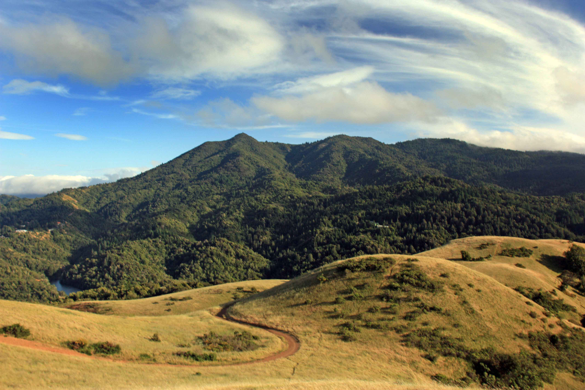

Advanced Maps and Interactors
Julia Daniel for Chris Piech
CS106A, Stanford University

Slide 2
You’re not Chris…

Slide 3
HashMap Recap
key
value
(String) animal
(String) name
(GRect) key
(String) animal sound
(int) phone number
(AudioClip) note

Slide 4
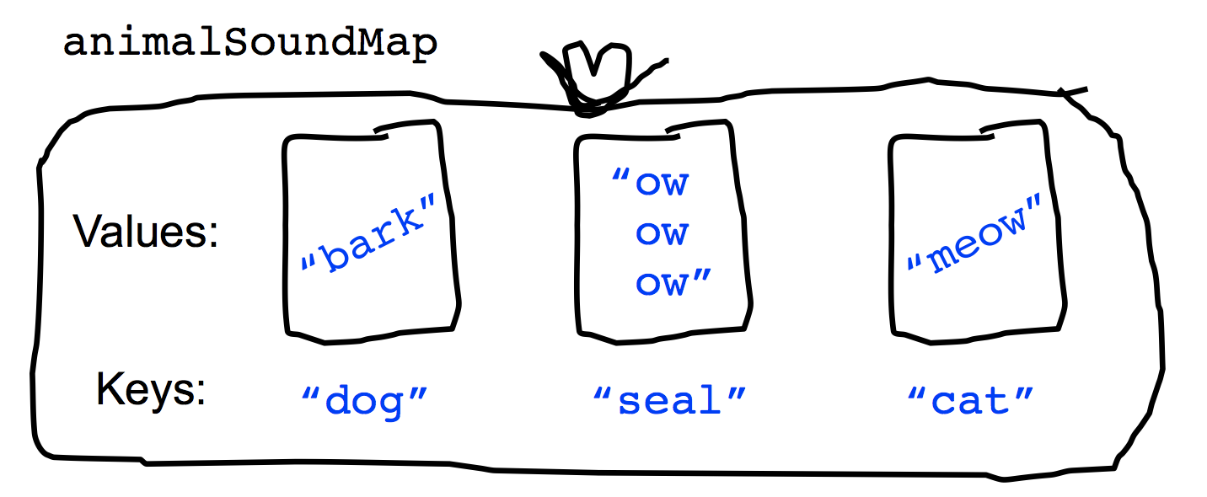
HashMap Recap
key
value
(String) animal
(String) name
(GRect) key
(String) animal sound
(int) phone number
(AudioClip) note

Slide 5
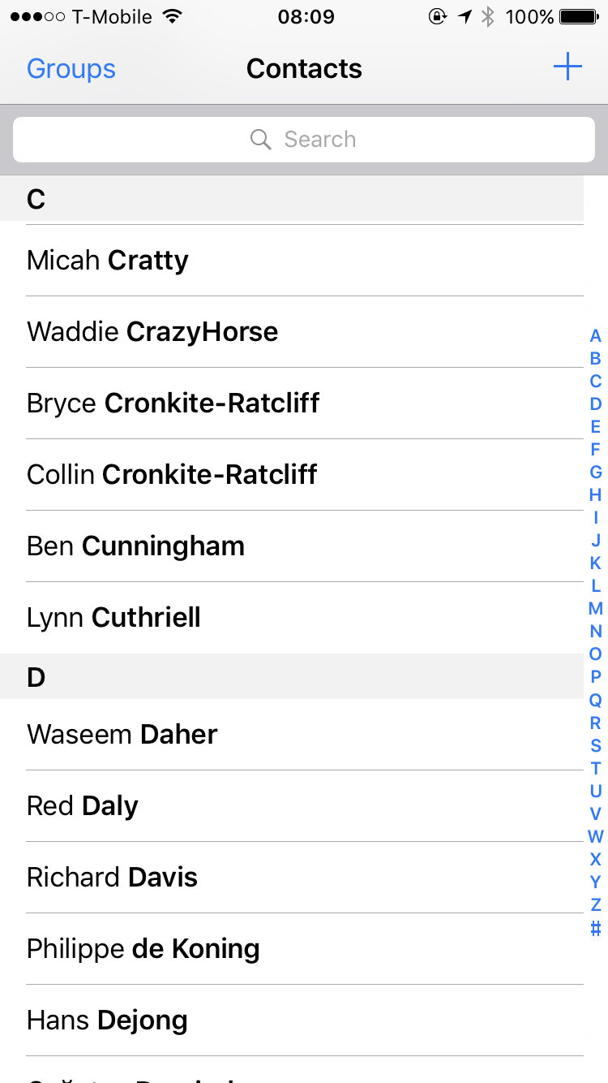
HashMap Recap
key
value
(String) animal
(String) name
(GRect) key
(String) animal sound
(int) phone number
(AudioClip) note
6701678

Slide 6
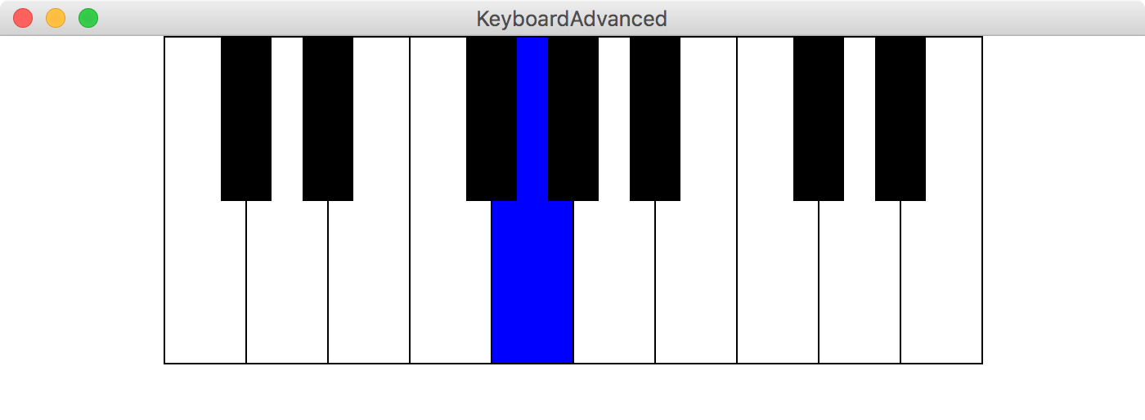
HashMap Recap
key
value
(String) animal
(String) name
(GRect) key
(String) animal sound
(int) phone number
(AudioClip) note

Slide 7
HashMaps on one slide
Make a HashMap
Put and get values into a map
Some useful other methods
int size = myMap.size();
myMap.contains(key); // returns true or false if key is in map
myMap.keySet();
myMap.remove(key); // make like a tree and leave!
Iterate using a foreach loop
HashMap<KeyType, ValueType> myMap =
new HashMap<KeyType, ValueType>();
myMap.put(key, value);
myMap.get(key) // returns the corresponding value
for(keyType key : myMap.keySet()){ // not ordered
myMap.get(key); // do something with the key/value pair }

Slide 8
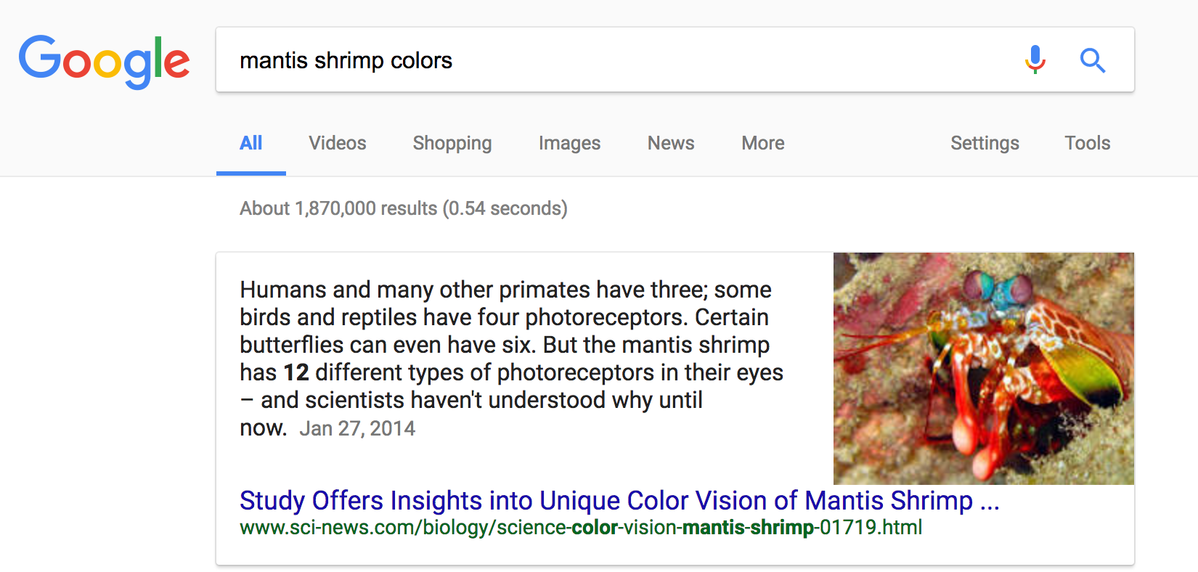
Why is this so fast?

Slide 9
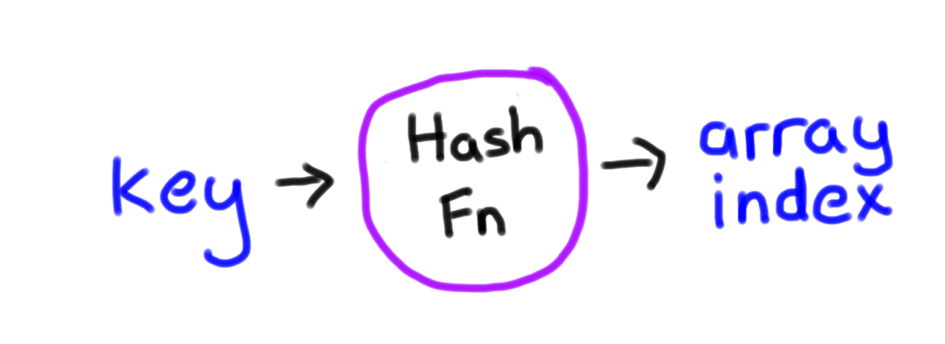
Why is this so fast?
int hash(string key);
* Learn more in CS106B

Slide 10
Why is this so fast?
int hash(string key);
(but we lose sortedness)
* Learn more in CS106B

Slide 11
Interactors

Slide 12
Where are we?
Karel the Robot
Java
Console Programs
Graphics Programs
Text Processing
Data Structures
GUIs
Defining our own Variable Types

Slide 13
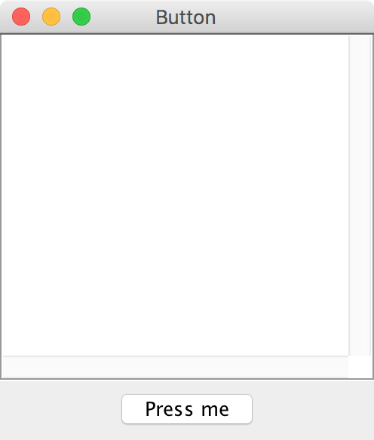
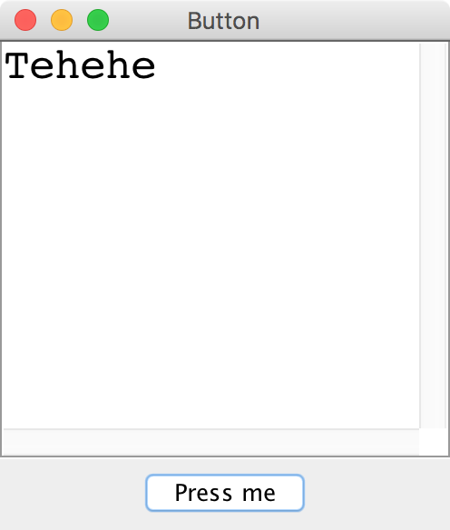
Button demo
Notes:
show Button example

Slide 14
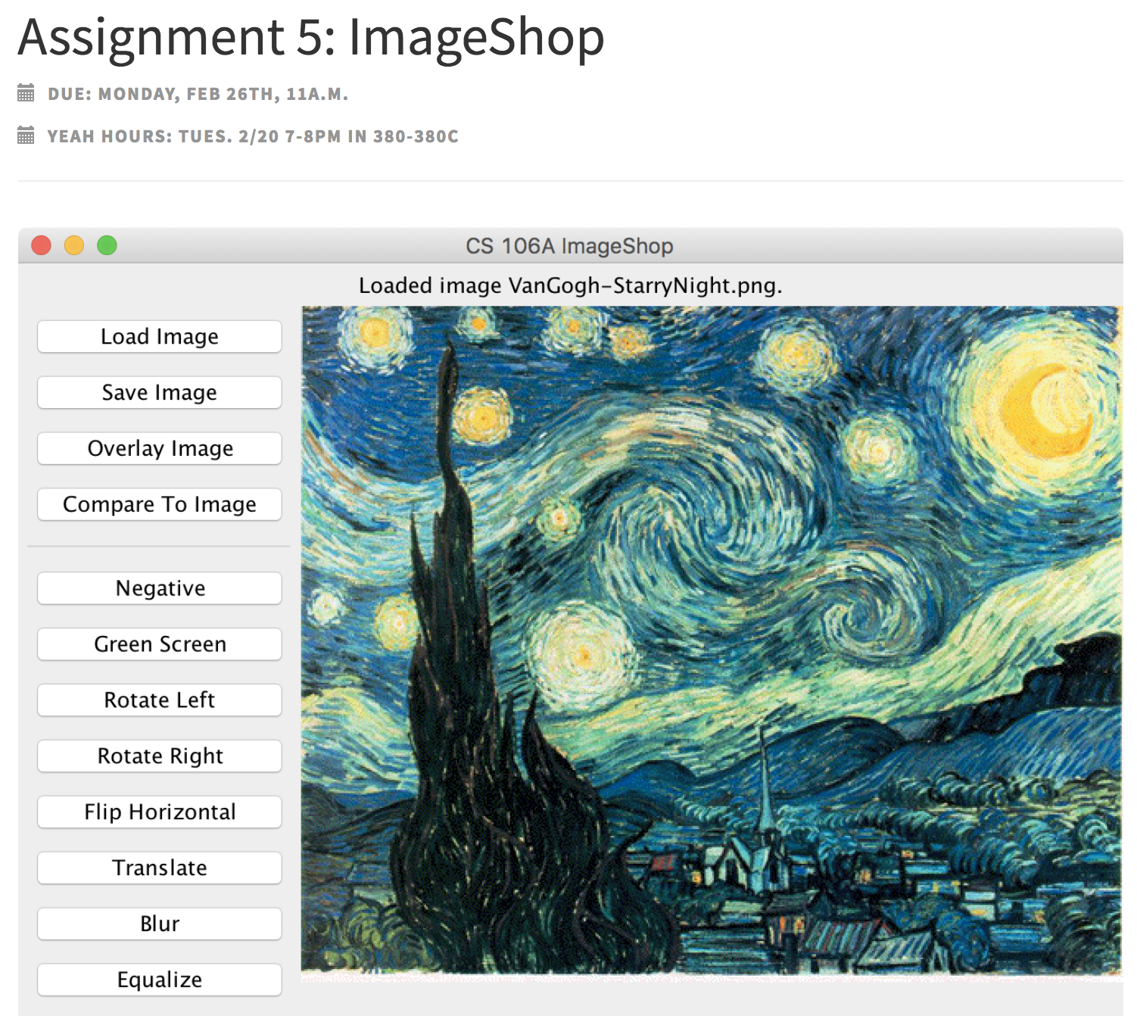
Look familiar?

Slide 15
Adding Iteractors
When you create an instance of any Program subclass, Java divides the window area into five regions as follows:
NORTH
WEST
EAST
CENTER
SOUTH
The CENTER region is typically where the action takes place. A ConsoleProgram adds a console to the CENTER region, and a GraphicsProgram puts a GCanvas there.
The other regions are visible only if you add an interactor to them. The examples in the text use the SOUTH region as a control strip containing a set of interactors, which are laid out from left to right in the order in which they were added.

Slide 16
JComponents
JComponent
JLabel
JButton
JTextField

Slide 17
JLabel

Slide 18
JLabel
JLabel label = new JLabel("Hi");

Slide 19
JLabel
JLabel label = new JLabel("Hi");

Slide 20
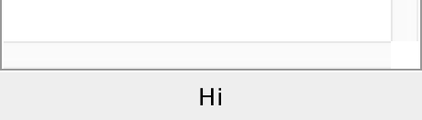
JLabel
JLabel label = new JLabel("Hi");
add(label, SOUTH);

Slide 21
JTextField

Slide 22
JTextField
JTextField field = new JTextField(10);
add(field, SOUTH);
field.getText(); // returns string in field
field.setText("Good times");

Slide 23
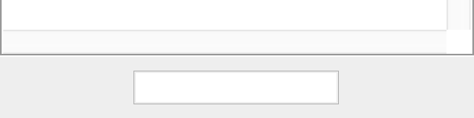
JTextField
JTextField field = new JTextField(10);
add(field, SOUTH);
field.getText(); // returns string in field
field.setText("Good times");

Slide 24
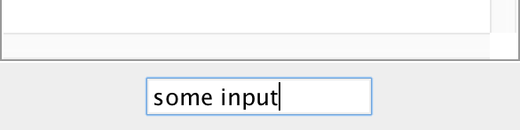
JTextField
JTextField field = new JTextField(10);
add(field, SOUTH);
field.getText(); // returns string in field
field.setText("Good times");

Slide 25
JTextField
JTextField field = new JTextField(10);
add(field, SOUTH);
field.getText(); // returns “some input”
field.setText("Good times");

Slide 26
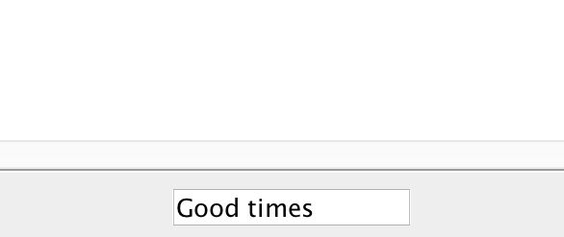
JTextField
JTextField field = new JTextField(10);
add(field, SOUTH);
field.getText(); // returns “some input”
field.setText("Good times");

Slide 27
JButton

Slide 28
JButton
JButton button = new JButton("Press me");

Slide 29
JButton
Button Text
JButton button = new JButton("Press me");

Slide 30
JButton
JButton button = new JButton("Press me");
add(button, SOUTH);

Slide 31
JButton
public void actionPerformed(ActionEvent e) {
println(e.getActionCommand());
}

Slide 32
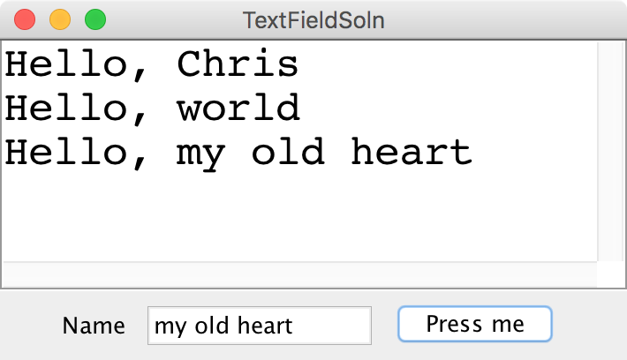
All together now
darkness
darkness

Slide 33
Recall the Dancing Children

Slide 34

Normal Program
Run Method

Slide 35
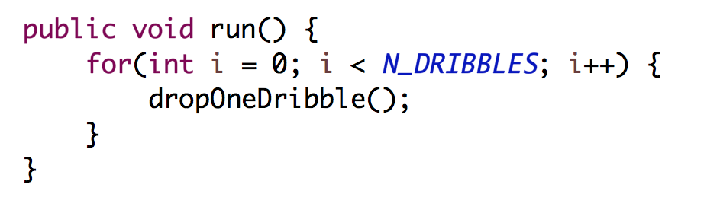
Normal Program
Run Method

Slide 36
Normal Program
Run Method

Slide 37
Normal Program
Run Method

Slide 38
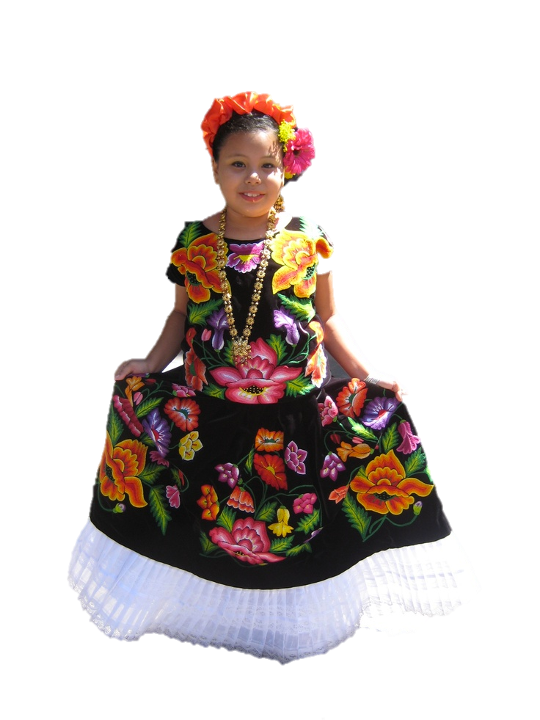
New Listener Characters
Action Listener
Action Performed

Slide 39
Program Starts Running
Run Method
Action Performed

Slide 40
Add Action Listeners
Run Method
Action Performed
Action Listener
addActionListeners();

Slide 41
Program Runs as Usual
Run Method
Action Performed
Action Listener

Slide 42

Button Clicked!
Run Method
Action Performed
Action Listener

Slide 43
Calls Action Performed Method
Run Method
Action Performed
Action Listener

Slide 44
When done, Run continues.
Run Method
Action Performed
Action Listener

Slide 45
Keeps Doing Its Thing…
Run Method
Action Performed
Action Listener

Slide 46
Button Clicked!
Run Method
Action Performed
Action Listener

Slide 47
Calls Action Performed Method
Run Method
Action Performed
Action Listener

Slide 48
When done, Run continues.
Run Method
Action Performed
Action Listener

Slide 49
Recall the Dancing Children

Slide 50
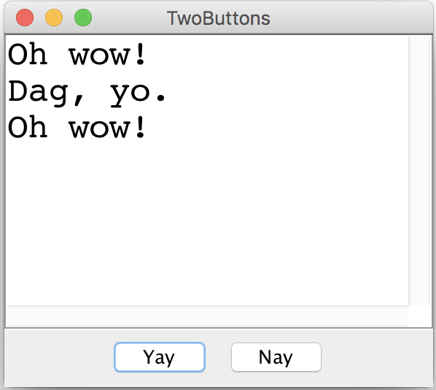
Two Buttons

Slide 51
something awesome
*idea credits to Keith

Slide 52

The XKCD Color Survey
Notes:
2/22/18
52
52

Slide 53
Notes:
2/22/18
53
53

Slide 54
Notes:
2/22/18
54
54

Slide 55
Notes:
2/22/18
55
55

Slide 56
The XKCD Color Survey
Volunteers (online) were shown a randomly-chosen color and asked to name the color.
The result is (after filtering) about 2.8 million RGB triplets and their names.
What do people think the colors are?
Notes:
2/22/18
56
56

Slide 57
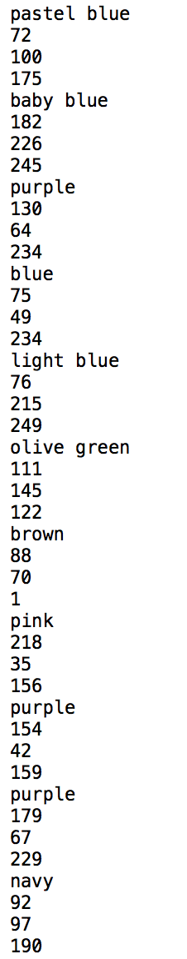
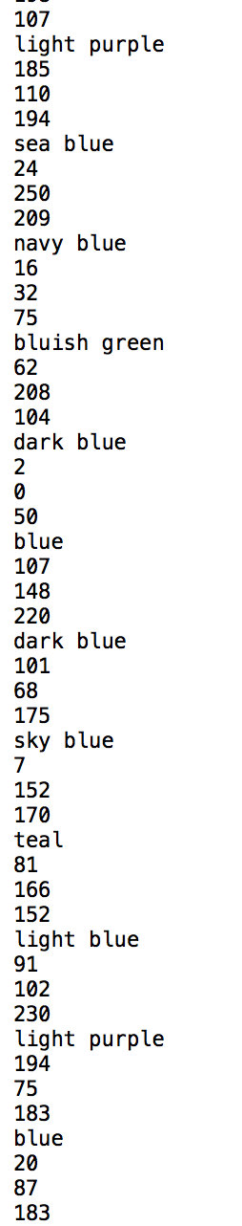
The File Format
color-name,
red,
green,
blue
Notes:
2/22/18
57
57

Slide 58
How to Structure Data
blue
15
137
255
0
0
127
88
88
190
red
166
14
7
99
55
5
255
0
0
gray
154
156
157
243
242
254
140
143
148
associate each color name
with a list of colors
Notes:
2/22/18
58
58

Slide 59
How to Structure Data
blue
15
137
255
0
0
127
88
88
190
red
166
14
7
99
55
5
255
0
0
gray
154
156
157
243
242
254
140
143
148
HashMap<color name, list of colors>
Notes:
2/22/18
59
59

Slide 60
How to Structure Data
blue
15
137
255
0
0
127
88
88
190
red
166
14
7
99
55
5
255
0
0
gray
154
156
157
243
242
254
140
143
148
HashMap<String, list of colors>
Notes:
2/22/18
60
60

Slide 61
How to Structure Data
blue
15
137
255
0
0
127
88
88
190
red
166
14
7
99
55
5
255
0
0
gray
154
156
157
243
242
254
140
143
148
HashMap<String, ArrayList<color>>
Notes:
2/22/18
61
61

Slide 62
How to Structure Data
blue
15
137
255
0
0
127
88
88
190
red
166
14
7
99
55
5
255
0
0
gray
154
156
157
243
242
254
140
143
148
BHashMap<String, ArrayList<Color>>B
Notes:
2/22/18
62
62

Slide 63
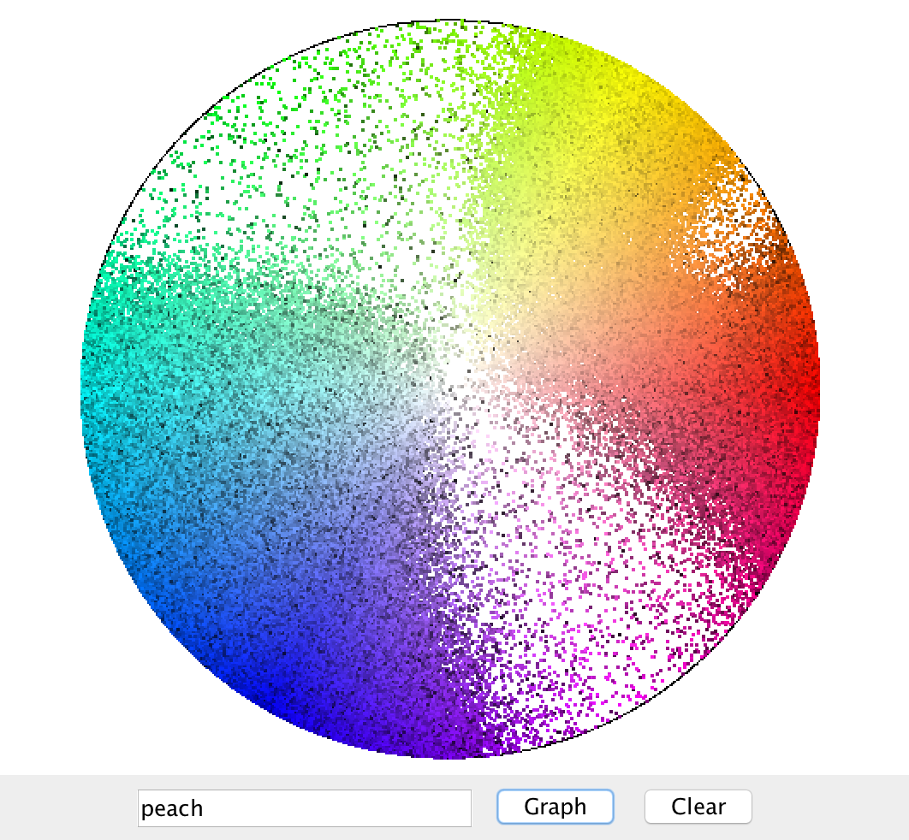
Displaying Colors
Notes:
2/23/18
63
63

Slide 64
Further Reading
http://blog.xkcd.com/2010/05/03/color-survey-results/
Notes:
2/22/18
64
64

